Slide 1
SHM Cont’
Instructor: Zonghua Gu

Slide 2
Matthew Barry, Gregory Horvath, Prototype Implementation of a Goal-Based Software Health Management Service, SMC-IT 2009
The FAILSAFE project is developing concepts and prototype implementations for software health management in mission-critical real-time embedded systems. The project unites features of the industry standard ARINC 653 Avionics Application Software Standard Interface and JPL’s Mission Data System (MDS) technology. The ARINC 653 standard establishes requirements for the services provided by partitioned real-time operating systems. The MDS technology provides a state analysis method, canonical architecture, and software framework that facilitates the design and implementation of software-intensive complex systems. We use the MDS technology to provide the health management function for an ARINC 653 application implementation. In particular, we focus on showing how this combination enables reasoning about and recovering from application software problems.

Slide 3
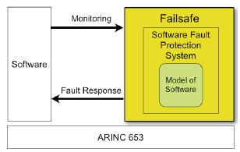
FAILSAFE Overview
Integrate various models of software performance and fault recovery to provide system-level software health management capabilities under ARINC 653 for high-assurance applications

Slide 4
Problem Addressed
Current failure recovery strategies prescribe limited actions in response to error conditions
reboot or failover to backup hardware
FAILSAFE proposes finer-grained granularity of fault protection, such that failures in a subsystem are isolated while the rest of the flight software continues to operate normally
e.g., monitor memory allocation to identify a component with memory leaks before memory is exhausted, and restart the faulty component.
Notes:
., in current practice
the response to an out-of-memory error may be a processor
reboot. In FAILSAFE the fault protection system will

Slide 5
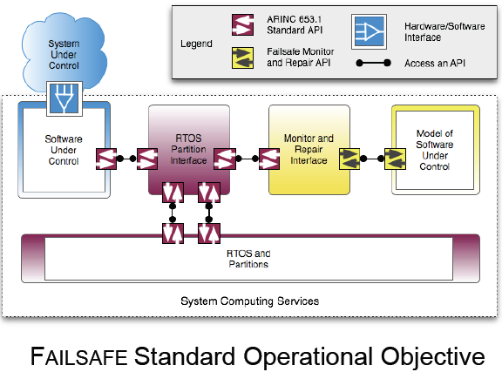
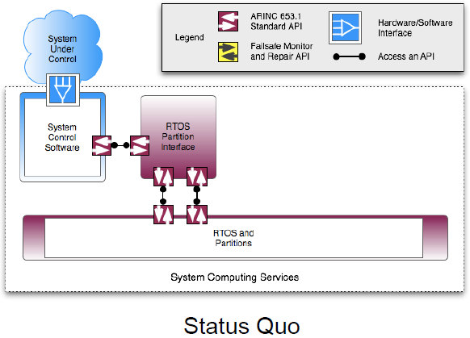
FAILSAFE Framework Components

Slide 6
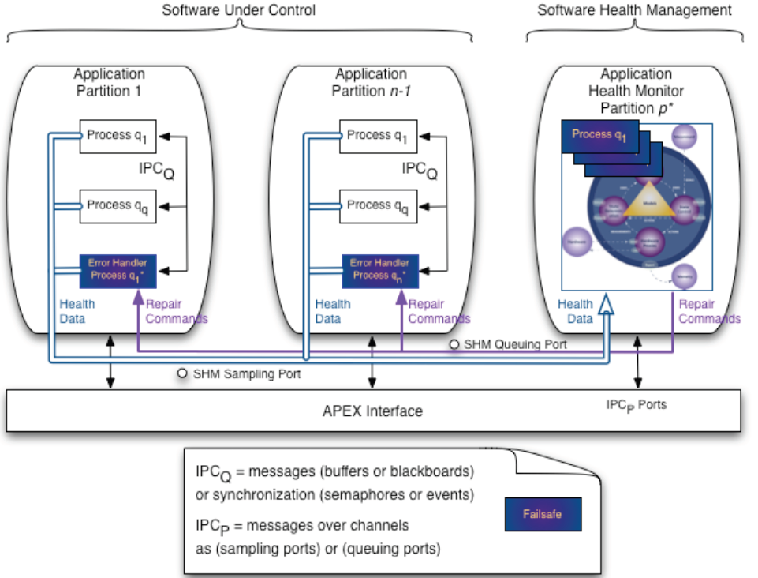
FAILSAFE Framework

Slide 7
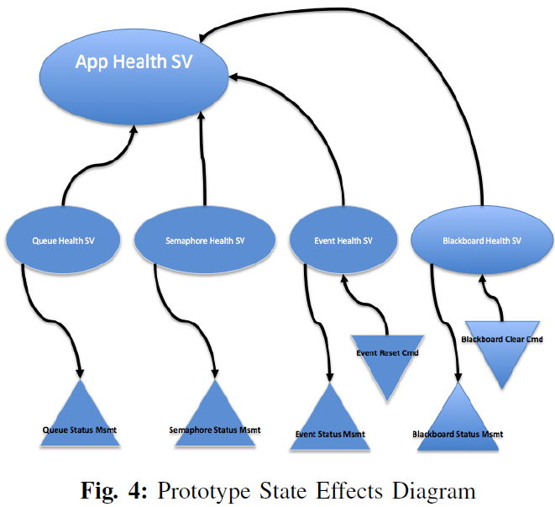
State Effects Diagram

Slide 8
ISWHM for Aircraft
ISWHM monitors the on-board software and sensors in order to:
Detect failures in hardware components and software
perform on-board reasoning to detect most likely root cause(s)
annunciate failures or initiate mitigation actions
Non-functional requirements:
small computational footprint
few false positives and false negatives
techniques/tools for V&V of ISWHM

Slide 9
SWHM Architecture
SWHM monitors
Software
OS
hardware sensors
Use Bayesian Networks for modeling

Slide 10
BN for ISWHM
A Bayesian ISWHM model
is a static BN (i.e., no temporal/dynamic BN)
uses a discretized BN
processes data from
• software sensors
• operating system/middleware
• hardware sensors
posterior distributions on health nodes provide information about their status
additional reasoning method for: sensitivity analysis and affected components

Slide 11
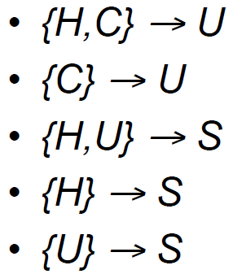
Bayesian Network Nodes
command node C: external inputs (ground truth)
sensor node S: process measurements that can be noisy, bad or unreliable
health node H: reflects health of sensor or (software) component
status node U: unobservable status
behavioral node B: used to detect behavioral patterns (e.g., oscillation)

Slide 12
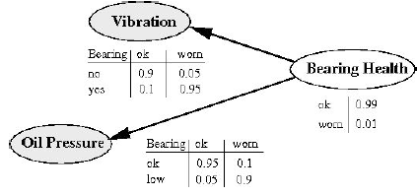
ISWHM Bayesian Health Model
BN edges reflect the structure of the system/software and capture substantial design knowledge.
Fault analysis reveals a number of network patterns
Bayesian health models can be constructed in a modularized manner

Slide 13
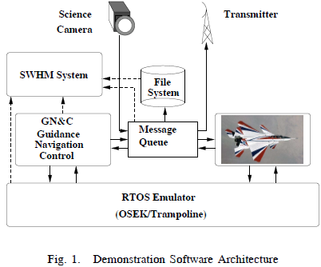
Demo Application
The GN&C software of an aircraft communicates with the aircraft’s sensors and actuators using a global message queue. This queue is also used to route data from a science camera to a transmitter, which downlinks the images. Furthermore, all messages going through the message queue are being logged to an on-board file system using blocking writes.
Problems can be caused by:
Overfull data storage (file system)
Logging of messages into an almost full storage or slow (blocking) telemetry)

Slide 14
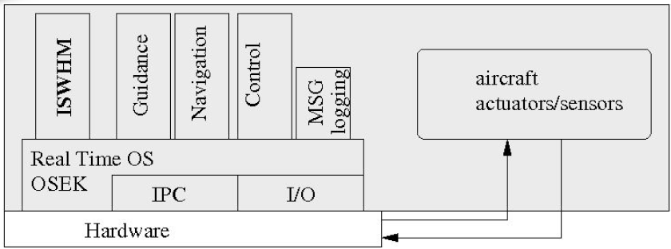
Demo Architecture
A small workstation-based aircraft GN&C model
F16 Simulink plant model
An emulated OSEK RTOS kernel,
Application processes: GN&C software, ISWHM executive, and the plant.
External logging and data analysis
Fault injection capability
Notes:
GN&C reside in individual processes
ISWHM executive is a separate process, which reads information about sensors, signals, OS information from shared resources
(available from Mathworks
website); C code for Simulink model + external
functions have been generated using Mathwork’s
RTW
which features multiple
processes, shared resources, semaphores, etc. to
Carry
No device drivers were emulated.
Shuttle Abort Control System (ACS) application running under the Wind River Systems VxWorks, or Vx653. There are 3 partitions:
Application itself runs in 2 partitions, one partition allocated to the sequencing behavior and one partition allocated to I/O.
HM runs in its own partition.

Slide 15
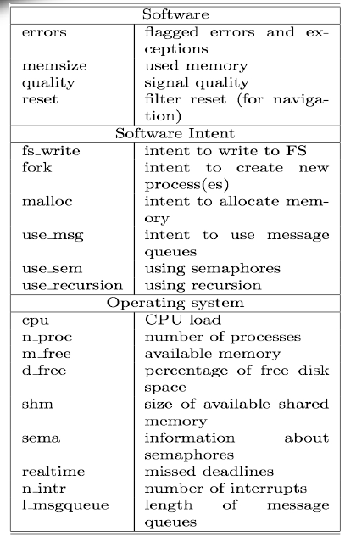
SW Sensors
Software and Sensor signals are time series
Signals are obtained from many sources
We perform feature extraction (e.g., min, moving average, FFT,...) to use discrete BN
Notes:
ISWHM takes multiple information sources into account
– radar altimeter
– position of stick
– pressure altimeter
– length and severity of error signals
Bayesian reasoning combines these sensor readings and produces most likely explanation
(in this case: do not trust radar altimeter reading)

Slide 16
Analyzed Fault Scenarios
1. File system (data storage) based faults
2. Inverted/crossed signals
3. Bad signal ranges
4. Inappropriate Signal Handling
5. Resource Allocation/Blocking
6. Priority Inversion
7. Transient signals
8. Bad/overlapping deadbands
9. Component-based diagnosis
10. Navigation: geometry-based fault detection
11. date line crossing
12. Euler angles
13. Signal quality and bias
14. Byzantine logic for redundant components

Slide 17
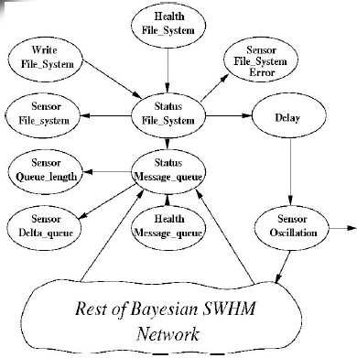
ISWHM Model
Shown: modular extension of BN
a systemwide “vibration / oscillation” sensor uses Fast Fourier transform (FFT) to detect vibration and or oscillation

Slide 18
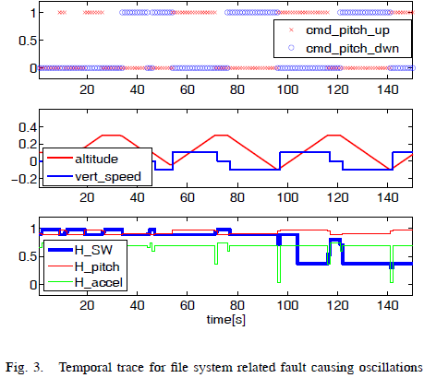

Slide 19
Antonio Bovenzi, Marcello Cinque, Domenico Cotroneo, Roberto Natella, Gabriella Carrozza: OS-level hang detection in complex software systems. IJCCBS 2(3/4): 352-377 (2011)
Many critical services are nowadays provided by large and complex software systems. However the increasing complexity introduces several sources of non-determinism, which may lead to hang failures: the system appears to be running, but part of its services are perceived as unresponsive. On-line monitoring is the only way to detect and to promptly react to such failures. However, when dealing with Over-The-Shelf based systems, on-line detection can be tricky since instrumentation and log data collection may not be feasible in practice.
In this paper, a detection framework to cope with software hangs is proposed. The framework enables the non-intrusive monitoring of complex systems, based on multiple sources of data gathered at the Operating System (OS) level. Collected data are then combined to reveal hang failures. The framework is evaluated through a fault injection campaign on two complex systems from the Air Traffic Management (ATM) domain. Results show that the combination of several monitors at the OS level is effective to detect hang failures in terms of coverage and false positives and with a negligible impact on performance.
Notes:
Antonio Bovenzi, Marcello Cinque, Domenico Cotroneo, Roberto Natella, Gabriella Carrozza: OS-level hang detection in complex software systems. IJCCBS 2(3/4): 352-377 (2011)

Slide 20
Anomaly Based Detection
These techniques rely on
(i) the continuous monitoring of the status of system variables (e.g., CPU consumption)
(ii) comparison of these data with traces of normal and anomalous executions.

Slide 21
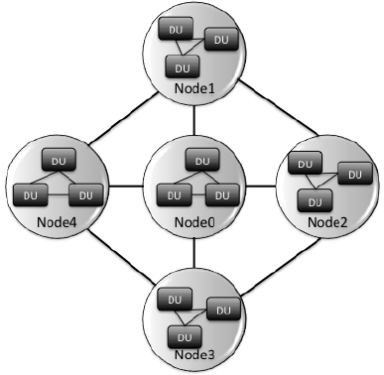
System Architecture
DU: Detectable Units
A DU represents the atomic software entity that can be monitored to detect failures.
SW process in this paper

Slide 22
OS Hangs
Active Hang
a process is still running but its activity may be no longer perceived by other processes because one of its threads consumes CPU cycles improperly
Passive Hang.
a process (or one of its threads) is indefinitely blocked (deadlocked)
Notes:
Passive Hang. It occurs when a process (or one of its threads) is indenitely
blocked, e.g., it waits for shared resources that will never be released (i.e., it
encounters a deadlock).

Slide 23
Design Goals
High coverage,
ability to notify a failure, when the system is actually affected by a hang;
Low false positive rate,
ability of avoiding false alarms when the DU is actually working properly;
Low latency
in order to trigger alarms in due time.
Low overhead
in order to minimize the impact on the mission of the system as a whole.

Slide 24
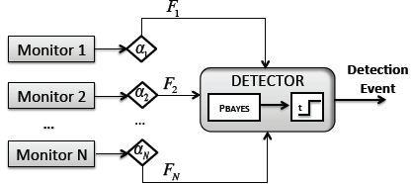
Detection Architecture

Slide 25
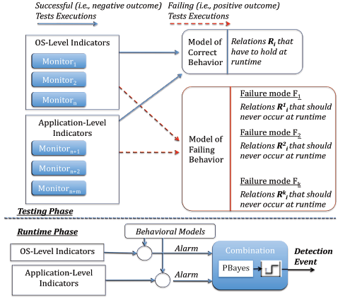
Detailed Framework

Slide 26
Monitored Variables
1. System call error codes;
2. OS signals;
3. Task scheduling timeouts;
4. Waiting time for critical sections;
5. Holding time in critical sections;
6. Process and thread exit codes;
7. Network sockets timeouts;
8. I/O throughput.

Slide 27
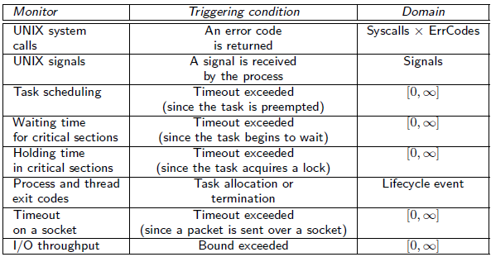
Monitors

Slide 28

Alert Generation
Variable v_{i} represents an event occurred for an OS
Range r_{i} models the expected behavior of the DU with respect to the monitored resource
e.g., a thread waited for 10ms before entering a critical section)
An alert is produced if the value of the observed variable v_{i} is out of a range r_{i} for L_{i} consecutive times in a period T_{i}

Slide 29
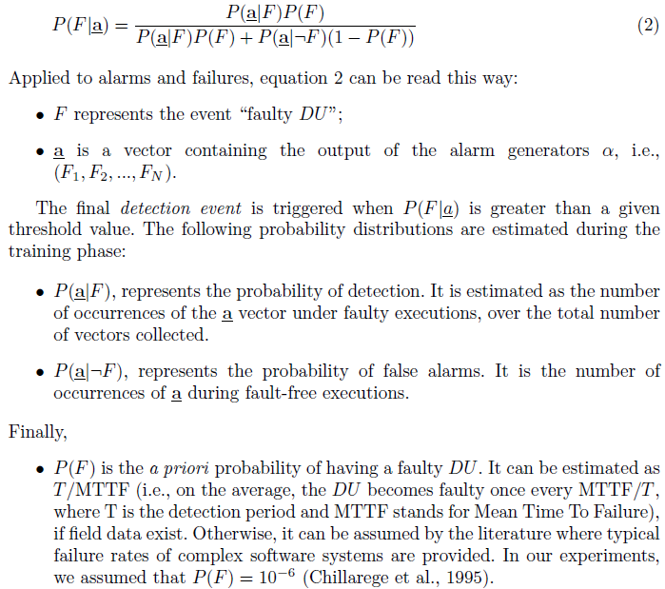
Bayesian Inference

Slide 30
Parameter Tuning
The parameters r_{i}, L_{i} and T_{i} are tuned during a preliminary training phase.
Distribution of the v_{i} (i.e., the frequency of values of v_{i}) is analyzed first, then a range r_{i} that includes the most of the distribution is selected.
Heuristics
the range can be selected by mean and the standard deviation:
Or min and max

Slide 31
Implementation in Linux
Detection framework is implemented as a Linux Loadable Kernel Module
KProbes framework to place breakpoints into kernel code
SystemTap tool for programming breakpoint handlers w/ scripting language

Slide 32
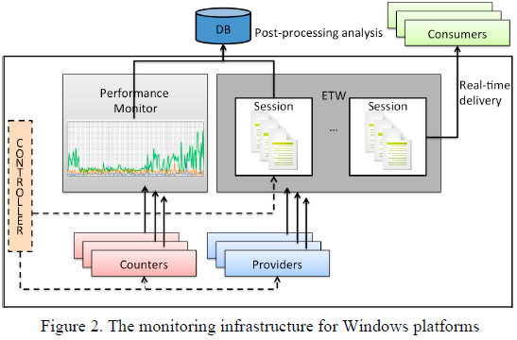
Implementation in Windows
Event Tracing for Windows (ETW)
ETW collects data from trace providers, which are components of the OS (kernel level) or of individual applications (user-mode level) that report actions or events.
Events monitored by this tool include:
Process (Thread) creations or terminations,
system call, disk I/O,
TCP/UDP
network I/O
context switches

Slide 33
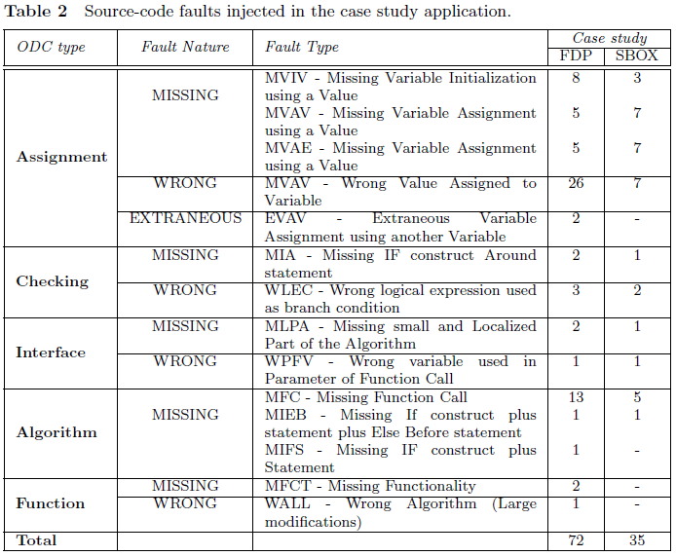

Slide 34
Domenico Cotroneo, Domenico Di Leo, Roberto Natella, Adaptive Monitoring in Microkernel Oss, DSN Workshop 2010
The microkernel architecture has been investigated by both industries and the academia for the development of dependable Operating Systems (OSs). This work copes with a relevant issue for this architecture, namely unresponsive components because of deadlocks and infinite loops. In particular, a monitor sends heartbeat messages to a component that should reply within a timeout. The timeout choice is tricky, since it should be dynamically adapted to the load conditions of the system. Therefore, our approach is based on an adaptive heartbeat mechanism, in which the timeout is estimated from past response times. We implement and compare three estimation algorithms for the choice of the timeout in the context of the Minix 3 OS. From the analysis we derive useful guidelines for choosing the best algorithm with respect to system requirements.

Slide 35
Heartbeat Timeout
Heartbeat mechanism,
a “ping” message is periodically sent to a component, and it is deemed unresponsive if a reply is not received within a timeout.
Timeout too short
a component that is performing a time-consuming computation can be erroneously considered unresponsive.
Timeout too long
an unresponsive component is detected after a long delay
Expected response time from a correct component can vary because of random factors, such as the user workload, I/O, and memory management.
Solution:
adaptively select the timeout, based on the history of response times of the component.

Slide 36
Assumption
Assumption: past response times can be used to estimate the near future.
Example:
A page fault is followed by more page faults when the memory references access to new data or instructions;
If a memory allocation or I/O operation is slowed down by memory exhaustion or fragmentation, following operations will likely be slow;
An intensive user workload will likely last until the user gets his work done.

Slide 37

EWMA (Exponential Weighted Moving Average)
Adopted by the TCP protocol to estimate the Round-Trip Time (RTT) over a connection. In this context, the RTT is exploited to set a timeout for TCP segments (i.e., segments are retransmitted if an acknowledge is not received within the timeout).
Two other algorithms are mentioned in the papr

Slide 38
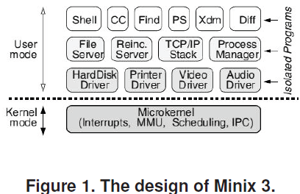
MINIX-3 Microkernel

Slide 39
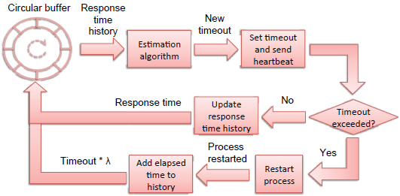
Framework Overview

Slide 40
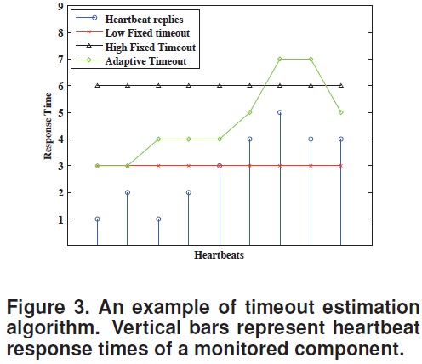

Slide 41
Concept and Prototyping of a Fault Management Framework for Automotive Safety Relevant Systems, Xi Chen, DSN 2007
One of the notable trends and challenges in the automotive electronics for the future Integrated Safety System is the increasing density of application software components with high dependability requirements. In the industry partnership EASIS, compiled of leading European OEMs and suppliers, a dependability software service “Fault Management Framework” is designed, prototyped and validated in order to manage the fault detection and coordinated ECU and system wide fault treatment.
This paper proposes the application of the Fault Management Framework service with error state management, supervision, logging and dynamic reconfiguration service for safety critical automotive systems. The prototyping of the Fault Management Framework, following the approach of “virtual integration”, was initiated with a model-based design with Matlab/Simulink and evaluated with the Software-in-the-Loop test. The interaction of the Fault Management Framework with other dependability software services was validated at last on a Freescale microcontroller S12XF in a Hardware-in-the-Loop validator.

Slide 42
Fault Management Framework
Main goals
To give a global view of the fault management issue
To ensure the consistency of the fault management strategies
To define central software artifacts for in-vehicle fault management and dependability
Focus of activities
Act upon error detection notification
Trace and identify faults
Tolerate faults
Other dependability activities
Notes:
.. Dependability and diagnosis services are part of a larger framework for on-board diagnosis
.. Fault management framework

Slide 43
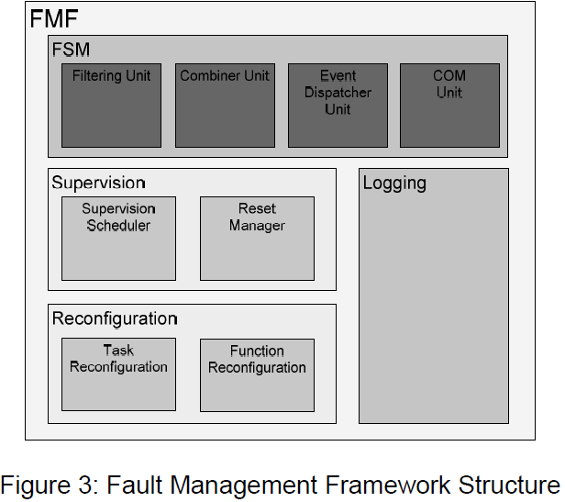
Fault Management Framework

Slide 44
Fault State Manager
Fault State Manager: the FSM is the core of the FMF since it receives the error reported from the software component and dispatches events to other units and software components. 4 sub-units
1. The filtering unit handles the filtering algorithms.
2. The combiner unit is responsible for updating the combined error.
3. The event dispatcher unit dispatches error events (i.e. change of error status) to event handlers.
4. The communication unit is responsible for distributing error information between the ECU local FMFs for a system wide fault treatment.

Slide 45
Supervision, Reconfiguration and Logging
Supervision Unit: decides which actions to perform next。 Implemented as a final state machine.
Reconfiguration Unit: provide mechanisms to reconfigure functions, runnables and tasks of the ECU. Functions can be activated or deactivated while tasks can additionally be restarted. Invoked by the Supervision Unit.
Logging Unit: the Logging Unit is responsible for managing the error history in non volatile memory, useful for later fault removal.
Notes:
(atomic code sequence of
applications)

Slide 46
SW Watchdog Functions
3 functions:
aliveness monitoring,
arrival rate monitoring
the program control flow checking
SW Watchdog informs Fault Management Framework, which can undertake different fault treatments depending on the source, type and severity of the detected faults.

Slide 47
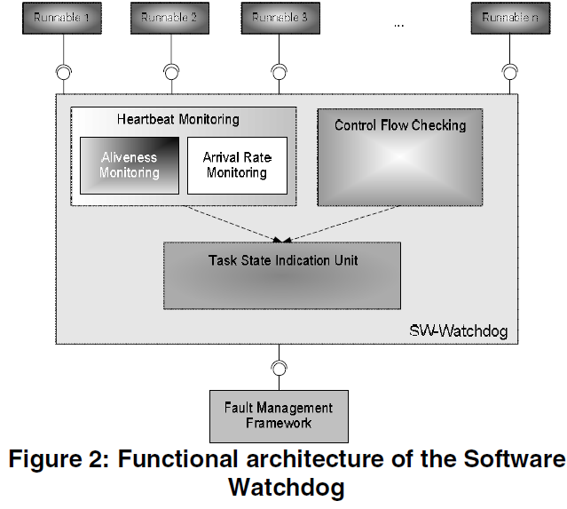
SW Watchdog
Heartbeat monitoring: record heartbeats from runnables
Control Flow Checking: monitors execution sequences of runnables
Task State Indication Unit: compares # detected errors to predefined thresholds
Notes:
other dependability software services in the EASIS software
topology, such as the
a general fault handling service in the platform, to

Slide 48
Heartbeat Monitoring
Heartbeats of each runnable in each monitoring period are saved in its Aliveness Counter (AC) and Arrival Rate Counter (ARC).
The monitoring periods are recorded in the Cycle Counter for Aliveness (CCA) and Cycle Counter for Arrival Rate (CCAR).

Slide 49
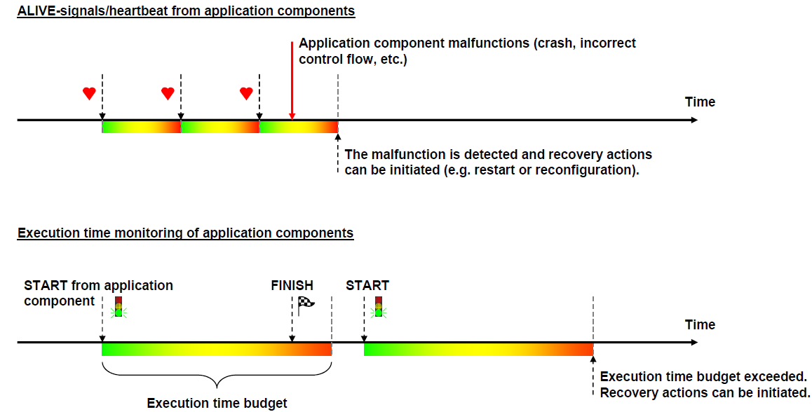
Heartbeat & Exec Time Monitoring

Slide 50
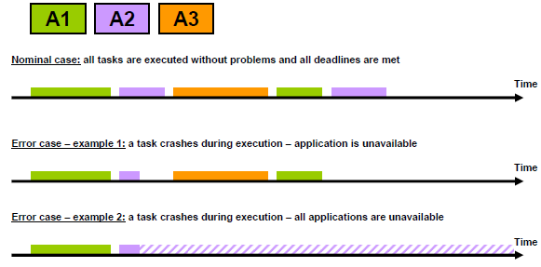
Task-Level Errors

Slide 51
Program Flow Checking
Detects runnable-level errors (within each task)
A look-up table stores all possible predecessor/successor relationships of the monitored runnables; They are compared to the actual execution sequence to detect control flow errors.
Other methods (not adopted) embedded signatures as proposed in [10], or with the watchdog processor as discussed in [13]
Notes:
[10] Nahmsuk Oh, P. Shirvani, E. McCluskey, "Control-
Flow Checking by Software Signatures," IEEE
Transaction on Reliability, vol. 51, Mar-2002, pp. 111-
121.
[13] T. Michel, et al., "A New Approach to Program Flow
Checking without Program Modification", Proc. 21st
Symposium on Fault-Tolerant Computing, pp. 334-341,
1991

Slide 52
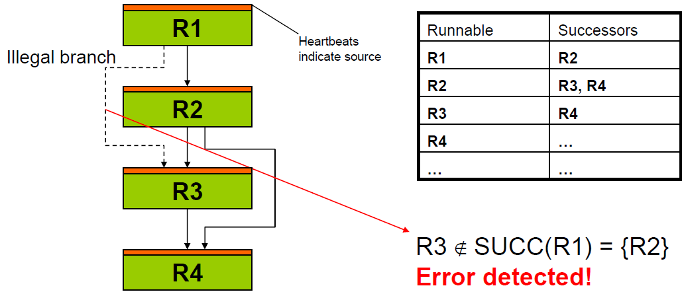
Program Flow Checking Example

Slide 53
Task State Indication
Task State Indication Unit keeps an error indication vector. If one of the elements in the error indication vector reaches the threshold, the whole task will be considered faulty.
If the global ECU state is “faulty”, the ECU might be subjected to a software reset depending on the requirements and constraints of applications.
If the global ECU state is “OK”, the “faulty” application software components might be restarted or terminated.

Slide 54
Fault Mitigation: Reconfiguration
Reconfiguration can be triggered by the FMF at 3 levels
Reconfiguration of active task set
Switch between predefined task sets
Functional inhibition
Passive w.r.t. platform→application receives info and has to act on this
ECU level reset
If all else fails →Ctrl-Alt-Del the ECU
Notes:
• Puts some constraints on mapping of runnables to tasks

Slide 55
EASIS Validator
A Hardware-in-the-Loop (HiL) system hosting a number of ISS-applications, such as the driver assistance applications, SafeLane and SafeSpeed.

Slide 56
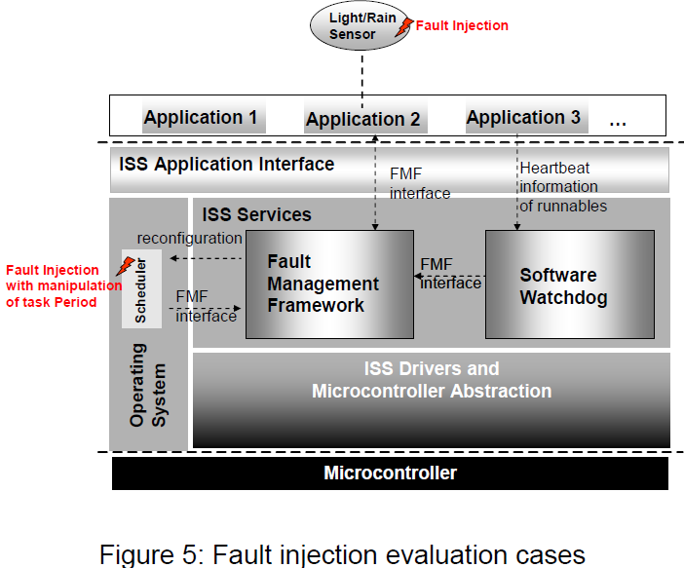
Fault Injection
Injection of sensor faults
Injection of task timing faults by changing task periods

Slide 57
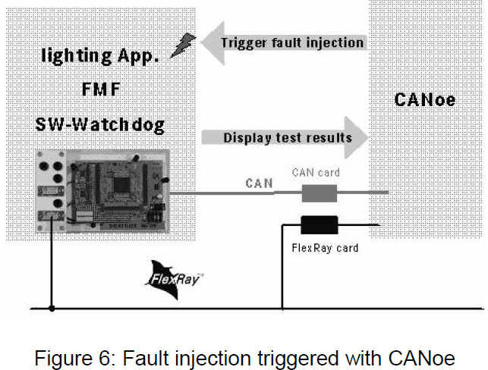

Slide 58
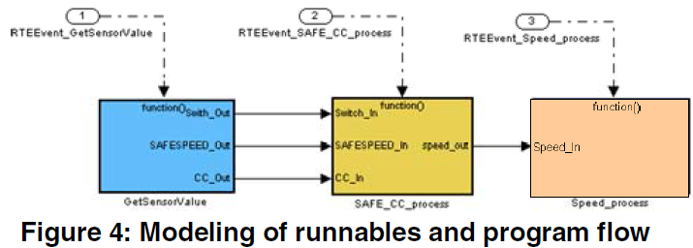
Application Example
The application has 3 runnables: GetSensorValue, SAFE_CC_process, Speed_process
These are triggered as function-call subsystems by the Stateflow chart SafeSpeed, which defines their execution sequence

Slide 59
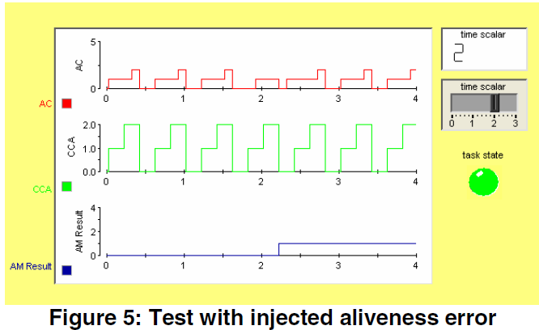
SW Watchdog
“Time Scalar” slider is used to change execution frequency
Upper fig shows Aliveness Counter (AC) and Cycle Counter for Aliveness (CCA)
Lower fig shows “AM Result” (Aliveness Monitoring Result) indicates the detection of the error at time 2.2.
Notes:
3 functions: detection of the aliveness error, the arrival rate error and the program flow error
Slider changes
Arrival Rate Counter (ARC).

Slide 60
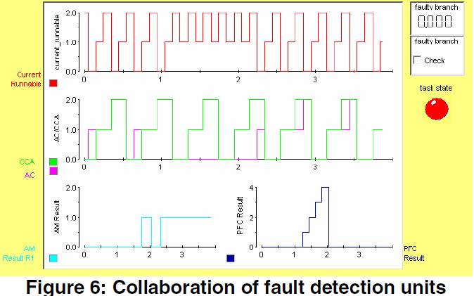
Fault Diagnosis
The aliveness errors detected by the heartbeat monitoring unit are actually caused by program flow errors, which are reported with the plot “PFC Result” (Program Flow Checking Result).
After detection of three program flow errors (the threshold), the task state is set to “faulty” (“task state” button is red).

